Slide 1
Overview of presentation given at IBMS Congress March 2022
Naomi Rogers – Pathology QM, EKHUFT

Slide 2
It’s all about the patient.
ISO 15189:2012 - What to expect from the new version

Slide 3

is for the patient

Slide 4
Inspection ready
…it’s for HTA
…must do this for MHRA
UKAS want us to do this…..
Audit
Risk assess
Maintenance
Competency
CAPA
SOP
EQA
IQC

Slide 5
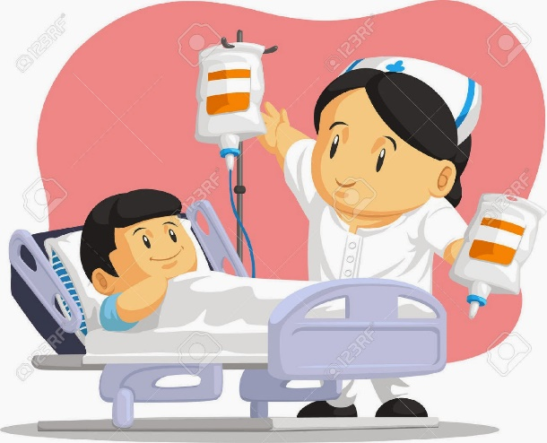
All for the patient…..
Fit for purpose
Satisfy user expectations
Consistent

Slide 6

Process
Everyday processes matter
Timely & expensive to fix mistakes
Review processes
Process rather than person

Slide 7
QMS
Workforce
Information management
Deliver high quality
User satisfaction

Slide 8
QMS
Commitment & contribution
Evidence
Trending
Improvement

Slide 9
GDP
Good documentation practice
Clear, accurate & timely
Review, audit, CAPA
Evidence, improvements

Slide 10
Documentation is only useful if 100% accurate
“If it’s not written down it’s a rumour….. if it’s not signed and dated, it’s graffiti” – FDA auditor

Slide 11
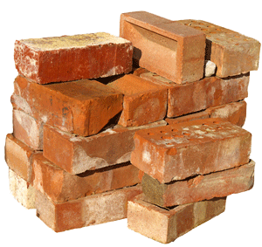
Why regulate?
Quality is built into organisations & processes
Evidence and assurance
Future service

Slide 12
Accreditation is just a spot check
“Quality means doing it right when no one is looking” – Henry Ford

Slide 13

ISO 15189
What to expect from the new version

Slide 14

Why update?
Update and alignment
Review period
Ongoing 3 years
49 countries involved

Slide 15

What changes to expect?
Translatable and applicable to a range of health systems
Legal and regulatory requirements priority
Not prescriptive
Minimum requirement

Slide 16
What changes to expect?
Patient focused
  Minimum requirement not maximum
  Labs need to strive to do the best they can
Risk focused
  Identify and mitigate risk
  Accept and monitor risk
  Look to improve patient care

Slide 17
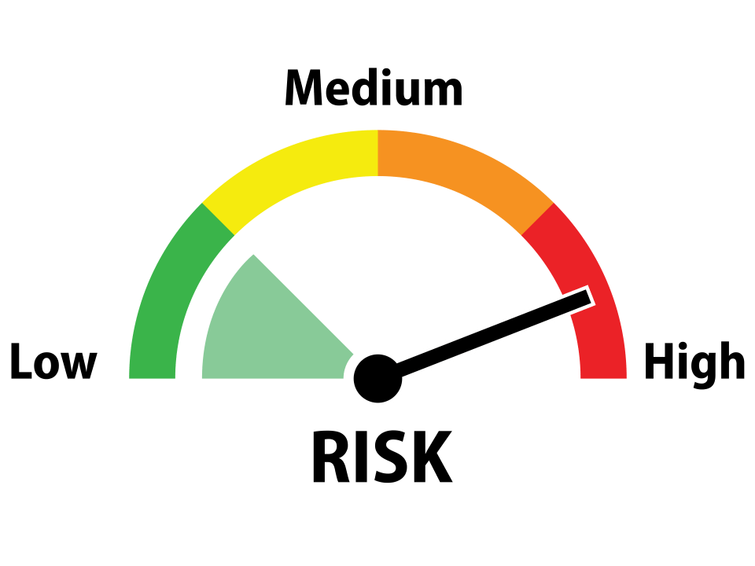
Decision – patient risk
No sample labelling requirements
Process or not process?
QC testing based on assay stability and patient risk

Slide 18

Terminology
“Examination request” not “request form”
“Shall” and “as appropriate” rather than “should”

Slide 19
POCT
Requirements incorporated into new standard – replace ISO 22870:2016
Transition period
Specific SLA’s with service being supported

Slide 20
When?
FDIS due to be agreed in coming weeks
Webinar - October 2022
Available in late 2022!
ILAC- ?3 years

Slide 21

How?
Needs careful reading to help implementation
BSI & UKAS working with IBMS & RCPath
UKAS training sessions and papers

Slide 22
KMPN
Consistency
  Templates (SOP, RA, competency)
  Style
  Terminology
  Processes (approval/review)

Slide 23

Any questions..

